Slide 1
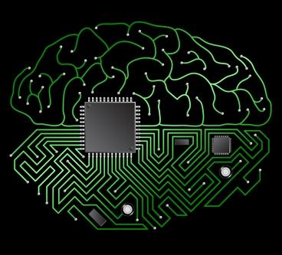
Can Computers Think?
PH1102E/GEK1067 Week 8

Slide 2
Today’s Plan
I. Review: consciousness & cognition
II. The computational theory of cognition
A. What is a computer?
B. The brain as a computer
III. Searle’s Chinese Room Argument
IV. Objections to the Chinese Room Argument
A. The Robot Objection
B. The System Objection

Slide 3
I. Review: Consciousness & cognition

Slide 4
Aspects of Mind
Conscious
(related to feelings)
Sensing
Perceptual sensations (five senses)
Bodily sensations (dizziness,
pain, fatigue, nausea, etc.)
Moods and emotions
Desire
Cognitive
(goal-setting and problem solving)
Thinking
Planning
Learning
Using & understanding language
Making decisions
Desire

Slide 5
Aspects of Mind
Conscious
(related to feelings)
Sensing
Perceptual sensations (five senses)
Bodily sensations (dizziness,
pain, fatigue, nausea, etc.)
Moods and emotions
Desire
Cognitive
(goal-setting and problem solving)
Thinking
Planning
Learning
Using & understanding language
Making decisions
Desire

Slide 7



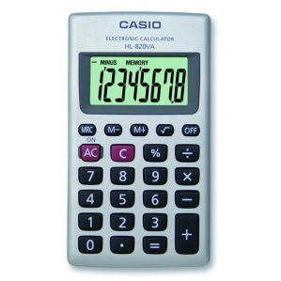
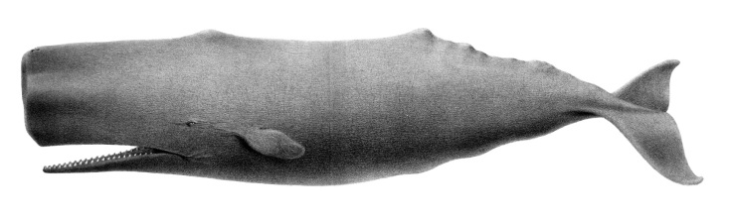






Slide 8
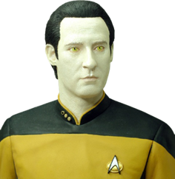
?

Slide 9
?
According to some philosophers, Data belongs with the thinking things.

Slide 10
But according to John Searle, he does not!

Slide 12
II. The computational theory of cognition

Slide 13
The computational theory of cognition says that to engage in cognitive activity (thinking, understanding, problem-solving, etc.) is just to have a brain that runs the right kind of computer program.
For example, to speak and understand Chinese is just to have a brain that runs a computer program that takes written or spoken Chinese words as input, and generates behavior (including utterances of Chinese words) as output.

Slide 14
The computational theory of cognition says that to engage in cognitive activity (thinking, understanding, problem-solving, etc.) is just to have a brain that runs the right kind of computer program.
For example, to speak and understand Chinese is just to have a brain that runs a computer program that takes written or spoken Chinese words as input, and generates behavior (including utterances of Chinese words) as output.

Slide 15
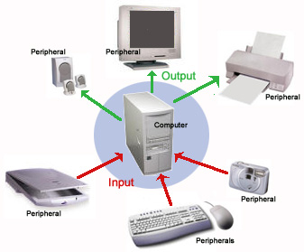

Slide 16
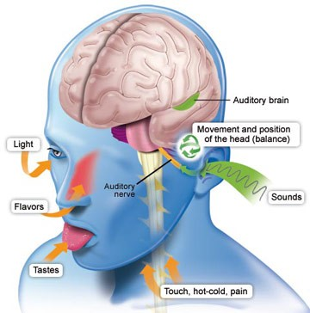

Slide 17
Computer Programs
A “program” (as Searle defines it) is any set of simple rules for manipulating symbols.
A simple rule is a rule that requires no intelligence or creativity to apply -- a rule that even a mindless mechanism can apply correctly.
A symbol is any intrinsically meaningless thing that we can create, erase, copy, store, transmit, or otherwise manipulate.

Slide 18
Computer Programs
What is a “computer program”?
A “program” (as Searle defines it) is any set of simple rules for manipulating symbols.
A simple rule is a rule that requires no intelligence or creativity to apply -- a rule that even a mindless mechanism can apply correctly.
A symbol is any intrinsically meaningless thing that we can create, erase, copy, store, transmit, or otherwise manipulate.

Slide 19
Computer Programs
What is a “computer program”?
A computer program is any set of simple rules for manipulating symbols.
A simple rule is a rule that requires no intelligence or creativity to apply -- a rule that even a mindless mechanism can apply correctly.
A symbol is any intrinsically meaningless thing that we can create, erase, copy, store, transmit, or otherwise manipulate.

Slide 20
Computer Programs
What is a “computer program”?
A computer program is any set of simple rules for manipulating symbols.
A simple rule is a rule that requires no intelligence or creativity to apply -- a rule that even a mindless mechanism can apply correctly.
A symbol is any intrinsically meaningless thing that we can create, erase, copy, store, transmit, or otherwise manipulate.

Slide 21
Computer Programs
What is a “computer program”?
A computer program is any set of simple rules for manipulating symbols.
A simple rule is a rule that requires no intelligence or creativity to apply -- a rule that even a mindless mechanism can apply correctly.
A symbol is any intrinsically meaningless thing that can be created, erased, copied, stored, transmitted, or otherwise manipulated.

Slide 22
The Brain as a Computer

Slide 23
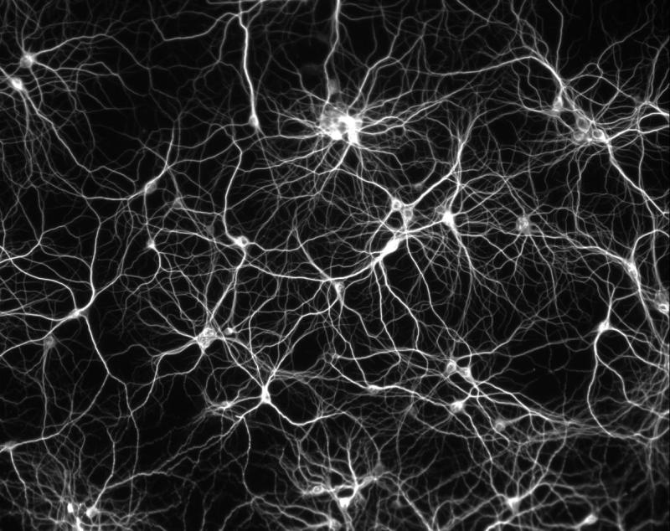
The Brain as a Computer
Consider an ordinary Chinese speaker’s brain. This, like any human brain, is a complex structure consisting of billions of inter-connected brain cells called neurons.

Slide 24
The Brain as a Computer
Each neuron is connected to other neurons by fibers, along which it can send and receive electrical or chemical impulses.

Slide 25
The Brain as a Computer
The overall pattern of brain-activity in someone who is understanding Chinese is immensely complex.

Slide 26
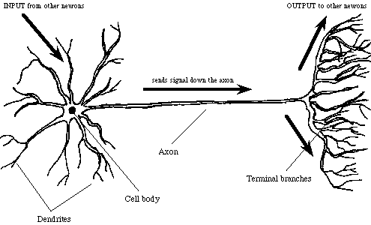
The Brain as a Computer
But what is happening in each individual neuron is actually quite simple.

Slide 27
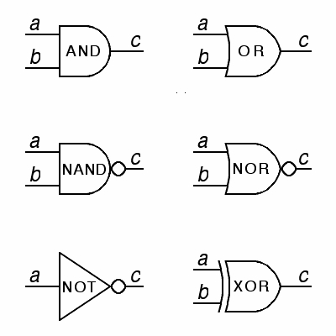
The Brain as a Computer
But what is happening in each individual neuron is actually quite simple.

Slide 28
The Brain as a Computer
“If you receive an impulse from neuron A, send an impulse to neuron B.”
Or like this:
“If you receive an impulse from neuron A and an impulse from neuron B, send an impulse to neuron C.”
Or maybe like this:
“If you receive two impulses in a row from neuron A, send one impulse to neuron B, and one impulse to neuron C.”

Slide 29
The Brain as a Computer
The point is that each neuron in a Chinese speaker’s brain operates according to a set of simple instructions.
The instructions have to be simple, since a neuron---which consists of a single cell---must be able to follow them.
The individual cells have no “meaning” or cognitive capability.

Slide 30
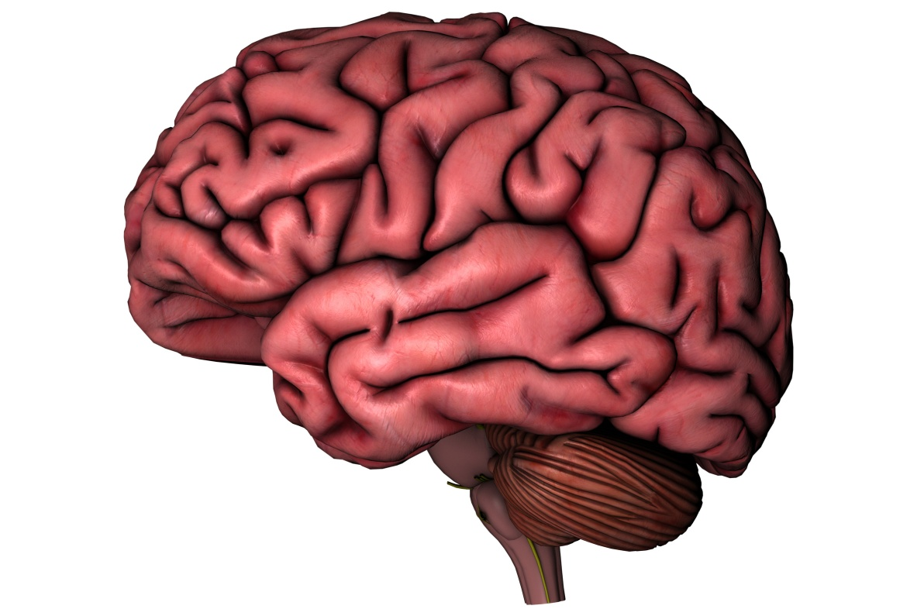
The Brain as a Computer
Yet, when networked together as in a Chinese speaker’s brain, these individual neurons, by following simple instructions for the manipulation of one another, collectively produce a perfect understanding of Chinese, along with a vast array of other cognitive capacities.

Slide 31
The Brain as a Computer
In other words: a Chinese speaker’s brain is a computer which, by following a biologically-encoded program for the manipulation of intrinsically meaningless neurons, manifests an understanding of Chinese.
This is the computational theory of cognition (as it pertains to Chinese language comprehension).

Slide 32
III. The chinese room argument

Slide 33

Is cognition just a matter of computation?
John Searle (1932- )

Slide 34
Is cognition just a matter of computation?
No.
John Searle (1932- )

Slide 35
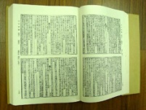
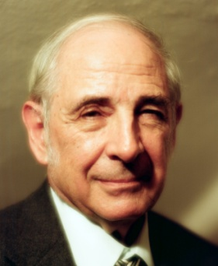
Searle imagines himself locked in a room with a lot of tables correlating meaningless -- to him -- ink marks, and a set of instructions (in English) for how to use them.

Slide 36
Column 1 Column 2
کیا رنگ آسمان ہے | نیلا
تم کرتے ہو اردو بولتے ہیں | ہاں
میرا کتا مر گیا | سنا ہے کہ کو معاف کر دو
میرے کتے کو پانچ سر تھا | میں آپ کو یقین نہیں کرتے

Slide 37
The Argument

Slide 38
The Argument
Searle’s argument against the computational theory of cognition is based on three claims.
If all three claims are true, it follows that running a computer program is never, by itself, enough to understand language.
If the argument works, parallel arguments can be used to prove that no form of computation, however sophisticated, can be sufficient for genuine cognition.

Slide 39
The Argument

Slide 40
The Argument
The person in the Chinese Room is computationally equivalent to an ordinary Chinese speaker, in all respects relevant to Chinese language comprehension.
According to the computational theory of the mind, anyone who is computationally equivalent to an ordinary Chinese speaker (in all relevant respects) understands Chinese.
So if the computational theory is true, it follows that the person in the Chinese Room understands Chinese. (1, 2)
But the person in the room does not understand Chinese.
Therefore, the computational theory is false. (3, 4)
Notes:
NOTE: “computationally equivalent” means: “runs the same computer program(s) as”

Slide 41
The Argument
The person in the Chinese Room is computationally equivalent to an ordinary Chinese speaker, in all respects relevant to Chinese language comprehension.
According to the computational theory of the mind, anyone who is computationally equivalent to an ordinary Chinese speaker (in all relevant respects) understands Chinese.
So if the computational theory is true, it follows that the person in the Chinese Room understands Chinese. (1, 2)
But the person in the room does not understand Chinese.
Therefore, the computational theory is false. (3, 4)

Slide 42
The Argument
The person in the Chinese Room is computationally equivalent to an ordinary Chinese speaker, in all respects relevant to Chinese language comprehension.
According to the computational theory of the mind, anyone who is computationally equivalent to an ordinary Chinese speaker (in all relevant respects) understands Chinese.
So if the computational theory is true, it follows that the person in the Chinese Room understands Chinese. (1, 2)
But the person in the room does not understand Chinese.
Therefore, the computational theory is false. (3, 4)

Slide 43
The Argument
The person in the Chinese Room is computationally equivalent to an ordinary Chinese speaker, in all respects relevant to Chinese language comprehension.
According to the computational theory of the mind, anyone who is computationally equivalent to an ordinary Chinese speaker (in all relevant respects) understands Chinese.
So if the computational theory is true, it follows that the person in the Chinese Room understands Chinese. (1, 2)
But the person in the room does not understand Chinese.
Therefore, the computational theory is false. (3, 4)

Slide 44

The Argument
The person in the Chinese Room is computationally equivalent to an ordinary Chinese speaker, in all respects relevant to Chinese language comprehension.
According to the computational theory of the mind, anyone who is computationally equivalent to an ordinary Chinese speaker (in all relevant respects) understands Chinese.
So if the computational theory is true, it follows that the person in the Chinese Room understands Chinese. (1, 2)
But the person in the room does not understand Chinese.
Therefore, the computational theory is false. (3, 4)

Slide 45
The Argument
The person in the Chinese Room is computationally equivalent to an ordinary Chinese speaker, in all respects relevant to Chinese language comprehension.
According to the computational theory of the mind, anyone who is computationally equivalent to an ordinary Chinese speaker (in all relevant respects) understands Chinese.
So if the computational theory is true, it follows that the person in the Chinese Room understands Chinese. (1, 2)
But the person in the room does not understand Chinese.
Therefore, the computational theory is false. (3, 4)

Slide 46
The Argument
The person in the Chinese Room is computationally equivalent to an ordinary Chinese speaker, in all respects relevant to Chinese language comprehension.
According to the computational theory of the mind, anyone who is computationally equivalent to an ordinary Chinese speaker (in all relevant respects) understands Chinese.
So if the computational theory is true, it follows that the person in the Chinese Room understands Chinese. (1, 2)
But the person in the room does not understand Chinese.
Therefore, the computational theory is not true. (3, 4)

Slide 47
IV. Objections to the Chinese Room argument

Slide 48
Robot Objection
The Program Equivalence Thesis states:
The person in the Chinese Room runs every program that a native speaker of Chinese runs when comprehending some Chinese sentence.
Advocates of the Robot Objection point out that this thesis is not true, given Searle’s description of the Chinese Room.

Slide 49
Robot Objection
Advocates of the Robot Objection point out that the person in the Chinese Room, as Searle describes it, is not computationally equivalent to an ordinary Chinese speaker in all relevant respects.

Slide 50
Robot Objection
An ordinary Chinese speaker can do many things that the person in the Chinese Room cannot.
Example: I pass Searle a slip of paper, and then, five minutes later, another slip with the words (in Chinese): “About how long has it been since you received the last slip of paper?”

Slide 51
Robot Objection
An ordinary Chinese speaker can do many things that the person in the Chinese Room cannot.
Example: I pass Searle an index card, and then, five minutes later, another card with the words (in Chinese): “About how long has it been since you received the last index card?”

Slide 52
Robot Objection
In order for Searle in the Chinese Room to be computationally equivalent to an ordinary Chinese speaker, Searle’s manuals would have to be somehow integrated with sensors that monitored his environment, and updated the manuals in real-time.
In effect, we’d have to integrate Searle with a robot capable of sensing its environment and updating its information just as an ordinary Chinese speaker does.

Slide 53
Robot Objection
Only if Searle were embedded in such a robot would his input-output architecture perfectly duplicate that of an ordinary Chinese speaker. So the fact that there is no understanding of Chinese in the non-robotic scenario that Searle describes is no threat to the computational theory of mind.

Slide 54
Searle’s Reply
Suppose we put the whole Chinese Room setup inside a robot equiped with cybernetic sensors which continually update the manuals in the room.
So what? The person in the Chinese Room (now embedded in a robot) still understands no Chinese. It’s still just Searle.

Slide 55

Searle’s Reply

Slide 56
Searle’s Reply
OK, suppose we put the Chinese Room (with me inside) in a giant robot’s head.
So what? I still don’t understand Chinese.
I might can’t even tell that I am inside a robot: it’s all the same to me.

Slide 57
Searle’s Reply
OK, suppose we put the Chinese Room (with me inside) in a giant robot’s head.
So what? I still don’t understand Chinese.
I might can’t even tell that I am inside a robot: it’s all the same to me.

Slide 58
Searle’s Reply
OK, suppose we put the Chinese Room (with me inside) in a giant robot’s head.
So what? I still don’t understand Chinese.
I can’t even tell that I am inside a robot: it’s all the same to me!

Slide 60
System Objection

Slide 61
System Objection
In the room, Searle himself is not computationally equivalent to any ordinary Chinese speaker.
Only the system as a whole has that computa-tional equivalence (provided that the system includes sensors, updating mechanisms, and other robotics).
Since Searle is just one part of this whole system, his inability to understand Chinese proves nothing against the computational theory of cognition.

Slide 62
System Objection
In the room, Searle himself is not computationally equivalent to any ordinary Chinese speaker.
Only the system as a whole has that computa-tional equivalence (provided that the system includes sensors, updating mechanisms, and other robotics).
Since Searle is just one part of this whole system, his inability to understand Chinese proves nothing against the computational theory of cognition.

Slide 63
System Objection
In the room, Searle himself is not computationally equivalent to any ordinary Chinese speaker.
Only the system as a whole has that computa-tional equivalence (provided that the system includes sensors, updating mechanisms, and other robotics).
Since Searle is just one part of this whole system, his inability to understand Chinese proves nothing against the computational theory of cognition.

Slide 64
Searle’s Reply

Slide 65
Searle’s Reply

Slide 66
Searle’s Reply
I, as the central process-ing unit have no way of figuring out what any of these symbols means; but then neither does the whole system.

Slide 67
Searle’s Reply
What Searle seems to be saying here is that if none of the components of the system understands Chinese, then the system as a whole cannot understand Chinese.
He thinks it is absurd to hold that you could create a Chinese speaker just by patching together a whole bunch of non-Chinese-speaking things (including Searle himself).
But: is this absurd?

Slide 68
Reply to Searle

Slide 69

Reply to Searle

Slide 70
Reply to Searle
A single spring or gear is not enough to keep time.

Slide 71

Reply to Searle
A single spring or gear is not enough to keep time.
But if you combine enough springs and gears together in the right way, the result is a watch, which can keep time..

Slide 72
Reply to Searle
A single spring or gear is not enough to keep time.
But if you combine enough springs and gears together in the right way, the result is a watch, which can keep time..

Slide 73

Reply to Searle
Another analogy: a single electrical switch is not enough to power a video game.

Slide 74
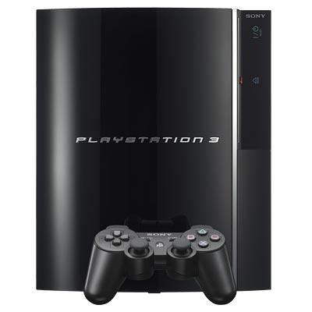
Reply to Searle
Another analogy: a single electrical switch is not enough to power a video game.
But if you combine enough switches together in the right way, you get a Sony PlayStation, which can power a video game.

Slide 75
Reply to Searle
Likewise, Searle-in-the-Chinese-Room cannot, by himself, understand Chinese.
But if we combine Searle in the right way with other components that are equally ignorant of Chinese (the instruction manuals, the robotic feedback sensors, etc.), we do get a system that understands Chinese.
At least, nothing that Searle has argued gives us a reason to think otherwise.

Slide 76
Reply to Searle
Likewise, Searle-in-the-Chinese-Room cannot, by himself, understand Chinese.
But if we combine Searle in the right way with other components that are equally ignorant of Chinese (the instruction manuals, the robotic feedback sensors, etc.), we do get a system that understands Chinese.
At least, nothing that Searle has argued gives us a reason to think otherwise.

Slide 77
Reply to Searle
Likewise, Searle-in-the-Chinese-Room cannot, by himself, understand Chinese.
But if we combine Searle in the right way with other components that are equally ignorant of Chinese (the instruction manuals, the robotic feedback sensors, etc.), we do get a system that understands Chinese.
At least, nothing that Searle has argued gives us any reason to think otherwise.

Slide 78
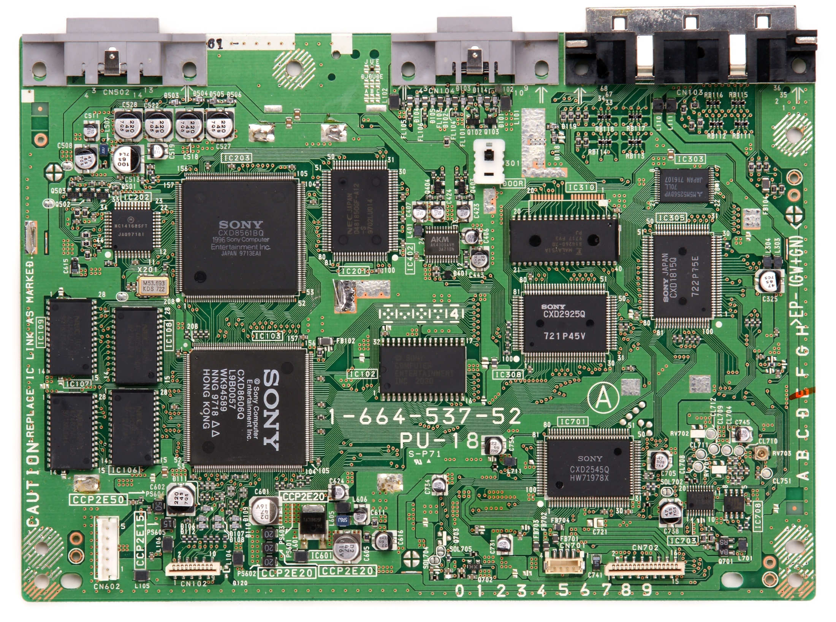
Notes:
Hard to believe that thought could take the form of electricity coursing through something like this…

Slide 79
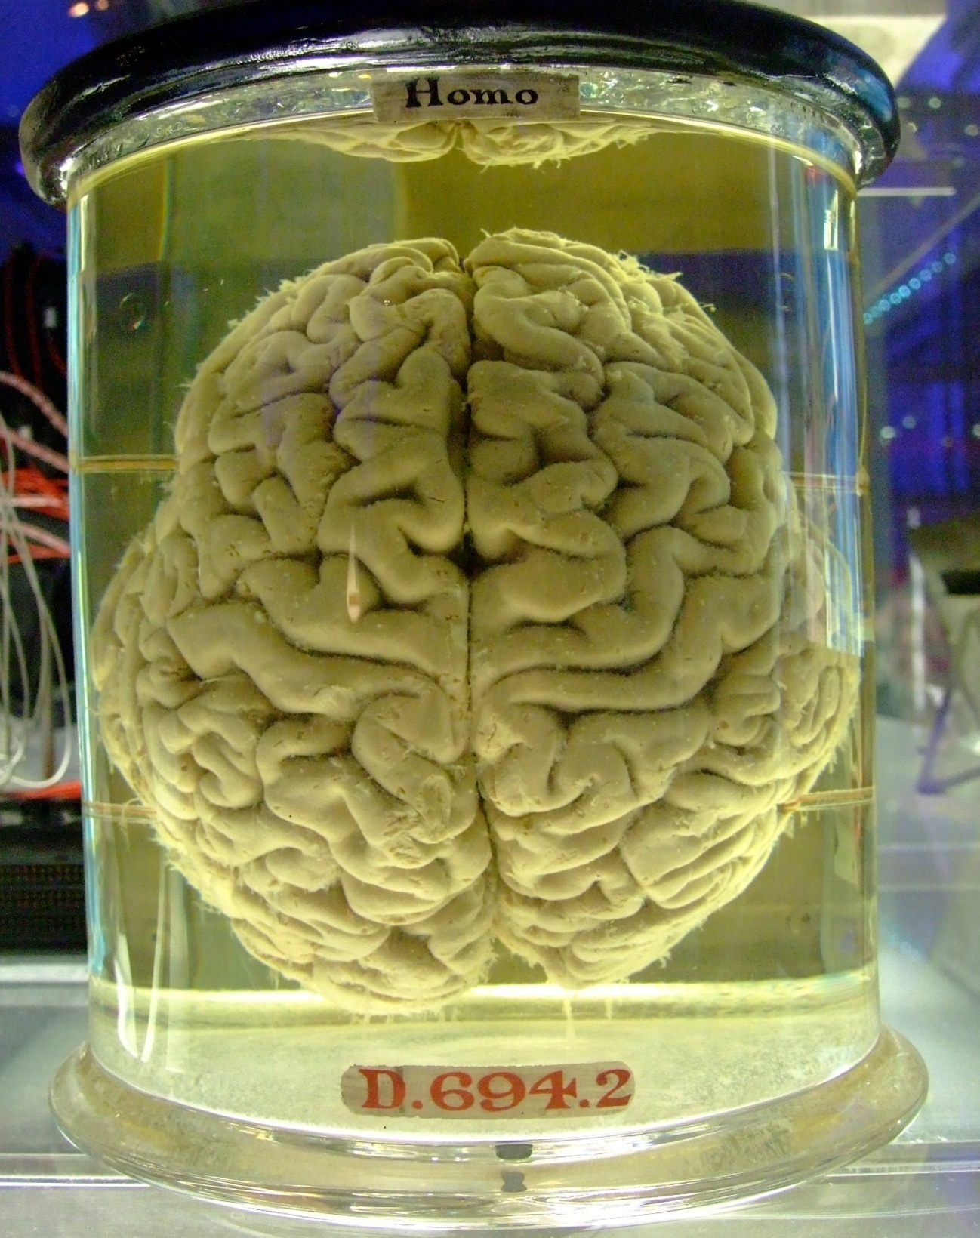
Notes:
But ALSO hard to believe it could take the form of electricity coursing through something like this!!

Slide 80
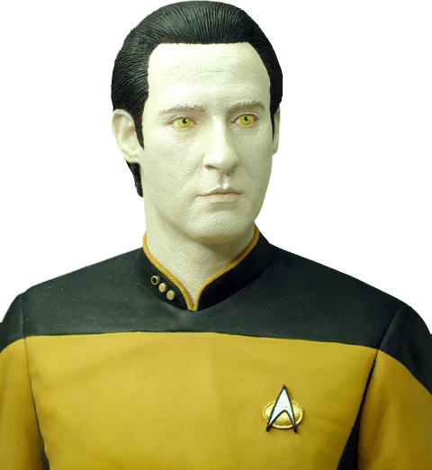

Slide 81
I told you so.

Slide 82
V. conclusions

Slide 83
The mind is defined by two main distinguishing features: consciousness and cognition.
Searle argues that genuine cognition is something that no computer can achieve: at most, a computer might simulate thought, in the way that it might simulate a thunderstorm.
But we know that brains are capable of cognition, and Searle fails to identify any relevant respect in which a computer must differ from a brain.
So Searle fails to make a convincing case for his claim that it is impossible to create a thinking computer.

Slide 84
The mind is defined by two main distinguishing features: consciousness and cognition.
Searle argues that genuine cognition is something that no computer can achieve: at most, a computer might simulate thought, in the way that it might simulate a thunderstorm.
But we know that brains are capable of cognition, and Searle fails to identify any relevant respect in which a computer must differ from a brain.
So Searle fails to make a convincing case for his claim that it is impossible to create a thinking computer.

Slide 85
The mind is defined by two main distinguishing features: consciousness and cognition.
Searle argues that genuine cognition is something that no computer can achieve: at most, a computer might simulate thought, in the way that it might simulate a thunderstorm.
But we know that brains are capable of cognition, and Searle fails to identify any relevant respect in which a computer must differ from a brain.
So Searle fails to make a convincing case for his claim that it is impossible to create a thinking computer.

Slide 86
The mind is defined by two main distinguishing features: consciousness and cognition.
Searle argues that genuine cognition is something that no computer can achieve: at most, a computer might simulate thought, in the way that it might simulate a thunderstorm.
But we know that brains are capable of cognition, and Searle fails to identify any relevant respect in which a computer must differ from a brain.
So Searle fails to make a convincing case for his claim that it is impossible to create a thinking computer.

Slide 87
End of lecture.

Slide 88
Weekly Assignment #8
What questions, if any, does the surgical procedure known as hemispherectomy raise about personal identity?
Limit: 200 words.
Upload by 8:00pm, Thursday 23 October.

